Slide 1

Random Variables
MATH30-6
Probability and Statistics

Slide 2
SPECIFIC OBJECTIVES:
At the end of the lesson, the student is expected to be able to:
Define a Random Variable
Differentiate a discrete from a continuous random variable
Determine the probability distributions opf a random Variable
Analyze and interpret probability problem in joint distributions

Slide 3
Probability
A function which assigns to each sample
point x in S a real number r.
X: S
Ṛ
p
r

Slide 4
Examples
1. Experiment: toss a pair of coin
Sample Space: {HH, HT, TH, TT}
Random Variable: X – number of heads
X = 0, 1, 2
X: S
Ṛ
HH
2
HT
1
TH
1
TT
0

Slide 5
Examples
2. Let X represents the difference between the number
of heads and the number of tails obtained when a
coin is tossed three times. What are the possible
values of X?
3. Three balls are randomly chosen from an urn
containing 8 white, 4 black, and two orange balls.
Let X be the number of black balls and Y be the
number of orange balls in any selection. Give the
values of the two random variables.

Slide 6
Probability Distribution Function
Let X be a random variable in an experiment. The
probability distribution function (pdf) of X is a
function which assigns to each value of X some
value r ϵ [0,1].
f: X
[0,1]
x
P(x)

Slide 7
Discrete Random Variable
Let X be a discrete random variable then f(x) is a probability function, probability mass function, or probability distribution of X if, for each possible outcome x,
f(x) ≥ 0
P( X = x ) = f(x)

Slide 8
Examples
1. Experiment: toss a pair of coin
Sample Space: {HH, HT, TH, TT}
Random Variable: X – number of heads
X = 0, 1, 2

Slide 9
Examples
2. Let X represents the difference between the number
of heads and the number of tails obtained when a
coin is tossed three times. What are the possible
values of probability of X?
3. Three balls are randomly chosen from an urn
containing 8 white, 4 black, and two orange balls.
Let X be the number of black balls and Y be the
number of orange balls in any selection. Give the
values of the two probability distributions.

Slide 10
Example
From a box containing four white balls and two red balls, three balls are drawn in succession, each ball being replaced in the box before the next draw is made. Find the probability distribution for the number of red balls.
Two balls are randomly chosen from an urn containing 8 white, 4 black, and two orange balls. Suppose that we win PHP 2.00 for each black ball selected and we lose PHP 1.00 for each white ball selected. Let X denotes our winnings. What are the possible values of X, and what are the probabilities associated with each value?

Slide 11
Continuous Probability Distributions
Let x be a continuous random variable. Then the function f(x) is a probability density function for the continuous random variable x, defined over the set of real numbers r, if
f(x) ≥ 0 for all x ∈ R

Slide 12
Continuous Probability Distributions
The total number of hours measured in units of 200 hours, that family runs a microwave oven over a period of one year is a continuous random variable x that has the density function
Find the probability that over a period of one year, a family runs their microwave
a. less than 300 hours
b. between 120 hours and 350 hours

Slide 13
Continuous Probability Distributions
A random variable x has a density function
where -∞ < x < ∞
Find the value of the constant k.
Find the probability that x² lies between 1/3 and 1.

Slide 14
Continuous Random Variable
The distribution function for a random variable X is
Find: (a) the density function;
(b) P(x >2);
(c) P(-3 < x < 4).

Slide 15
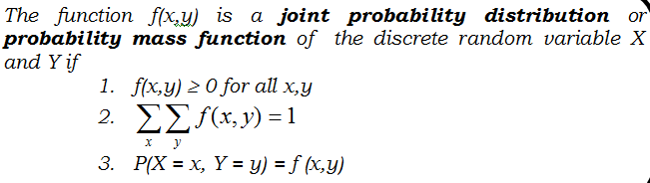
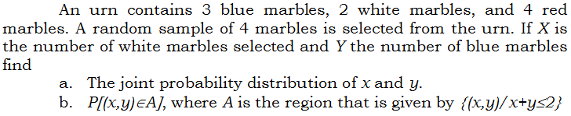
Joint Probability Distribution

Slide 16
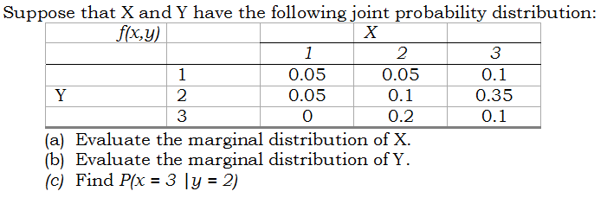
Seatwork

Slide 17
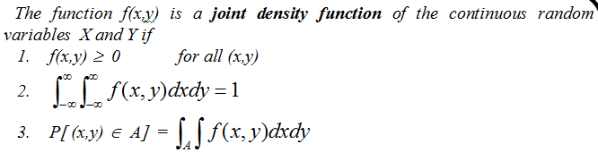
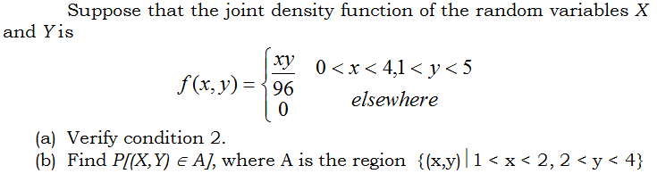
Joint Probability Distribution

Slide 18
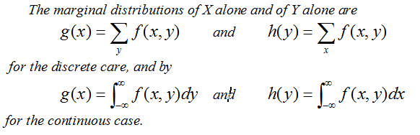
Marginal Distributions

Slide 19
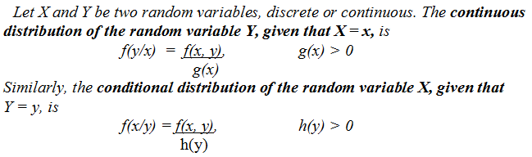
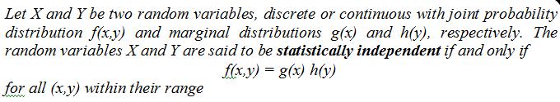
Conditional Probability Distribution
Statistical Independence

Slide 20
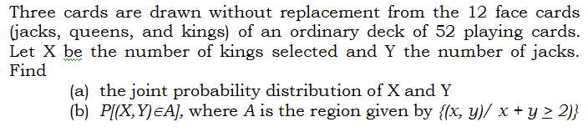
Example

Slide 21
HOMEWORK
Three cards are drawn without replacement from the 12 face cards (jacks, queens, and kings) of an ordinary deck of 52 playing cards. Let X be the number of kings selected and Y the number of jacks.
Find the joint probability distribution of X and Y
Determine the marginal distributions of X and Y
Find the probability that there would be a single king, given that there would be a Jack in the selection.
Find the probability that there would be 2 Jacks, given that there is no King in the selection?
Are the number of king and Jacks statistically independent?

Slide 22
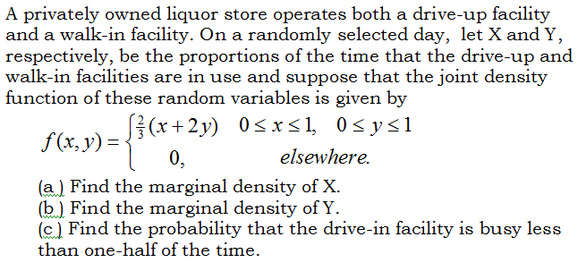
Seatwork
(d) Are the random variables X and Y statistically independent?
(e) Find the probability that both x and y would be busy more than
half of the time?

